Slide 1
Project 265 Group 01 Submitted by:
Mr. Joshi Atharva Atul
Ms. Vaishnavi Ashok Shinde
Mr. Sudarshan Subhash Bane
Ms. Pooja Baban Thakare
Ms. Saloni Surendra Alshi

Slide 2
Regression Analysis CO2-Emission-by-Cars
/

Slide 3
INTRODUCTION
When a petrol or diesel engine burns fuel it produce carbon dioxide(CO2),along with a handful of other harmful gases. This CO2 is then emitted through the vehicles exhaust pipe. The amount of CO2 in vehicle emits into the atmosphere is measured in grams per kilometer – often shortened to g/km- and is considered to be an indication of how kind a vehicle is to the environment.
In general, the lower this figure, the less fuel that a vehicle uses: a car with 90g/km CO2 , should have good fuel economy. One with 180g/km CO2 or more will use a lot of fuel. So consumers looking to reduce their running costs ought to be looking out for cars with fewer emission.

Slide 4
CO2 EMISSION
Carbon dioxide(CO2) is released into earth’s atmosphere mostly by the burning of carbon-containing fuel and decay of wood and other plant matter. Under all conditions found naturally on earth CO2 is an invisible, odorless gas. It is removed from the atmosphere mostly by plants, which extract carbon from CO2 to build their tissues and by the oceans in which CO2 dissolves
Although other gases are also causing Earths Climate to warm, CO2 alone is responsible for about three-fourths of global warming.
The amount of CO2 in the atmosphere has increased greatly since human being began burning large amount of coal and petroleum in the nineteenth century

Slide 5
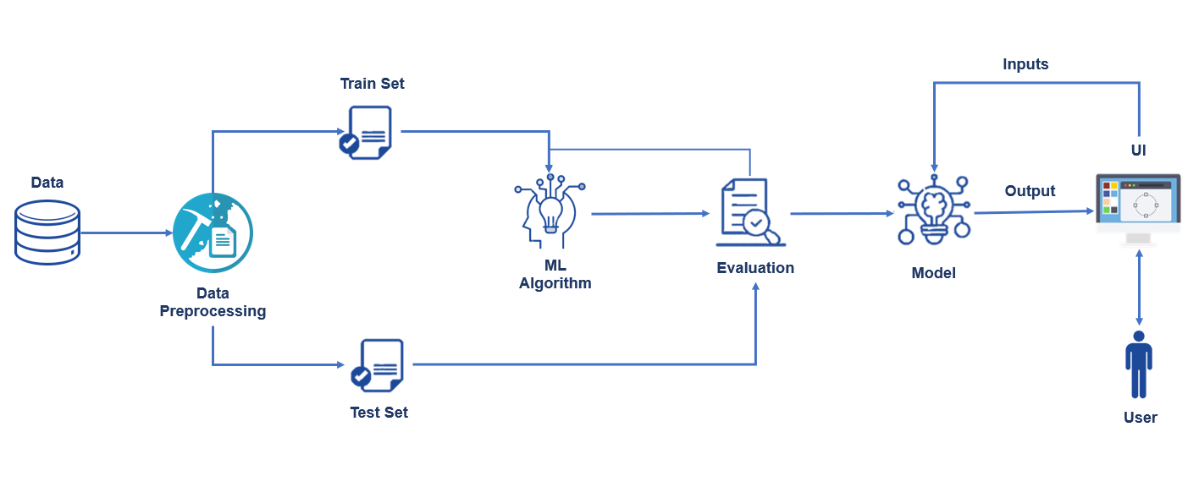
ARCHITECTURE

Slide 6
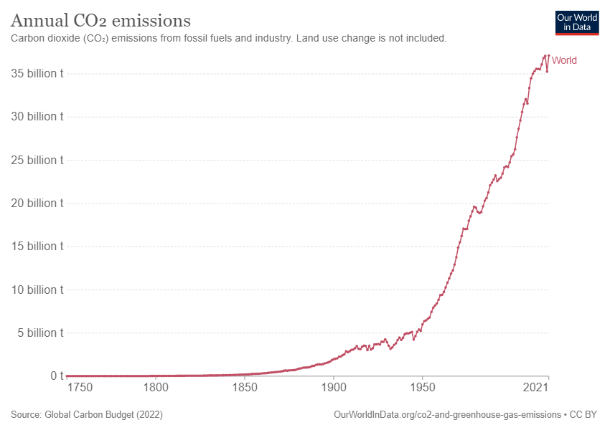
GRAPH OF ANNUAL CO2 EMISSION

Slide 7
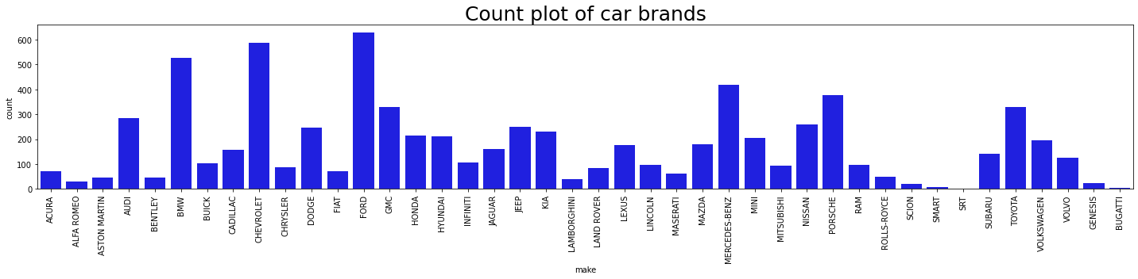
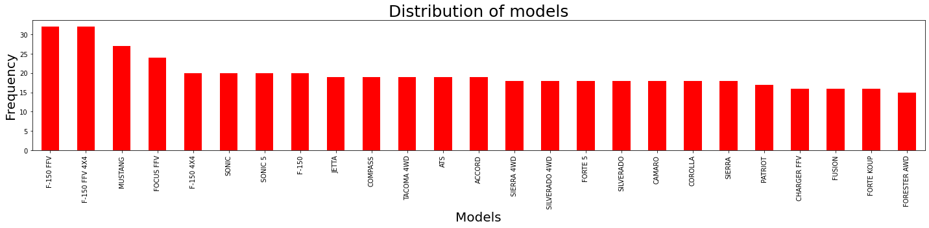
EDA (Univariate Analysis)

Slide 8
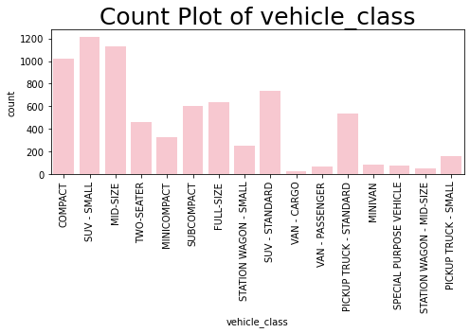
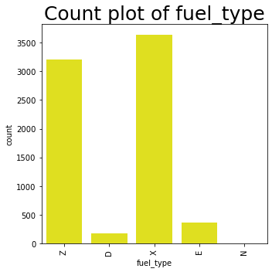
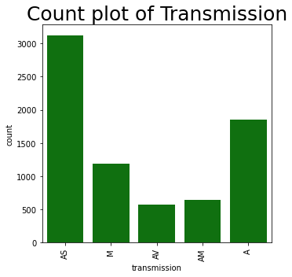

Slide 9
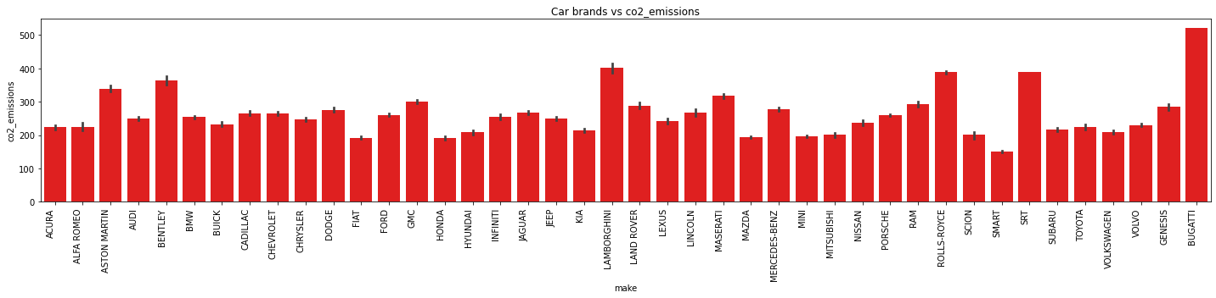
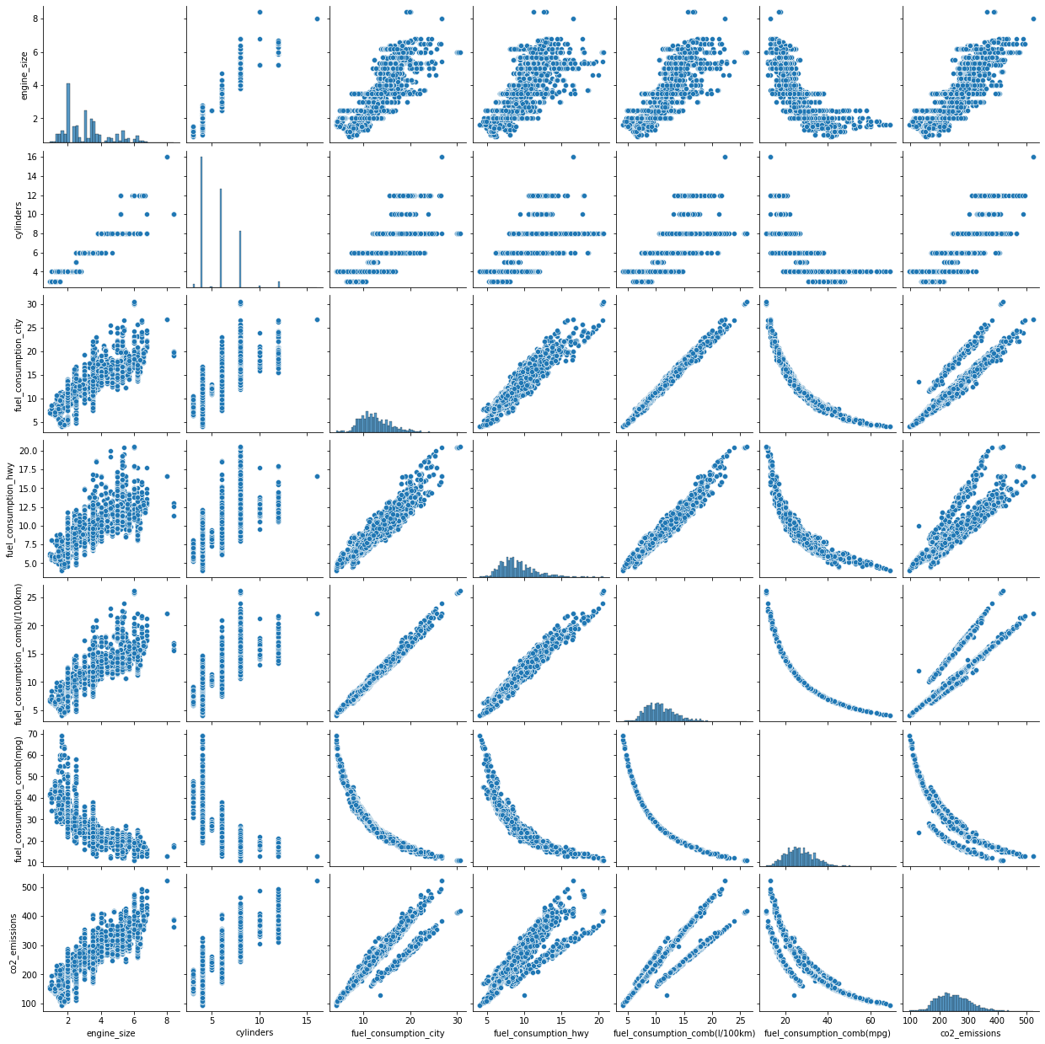
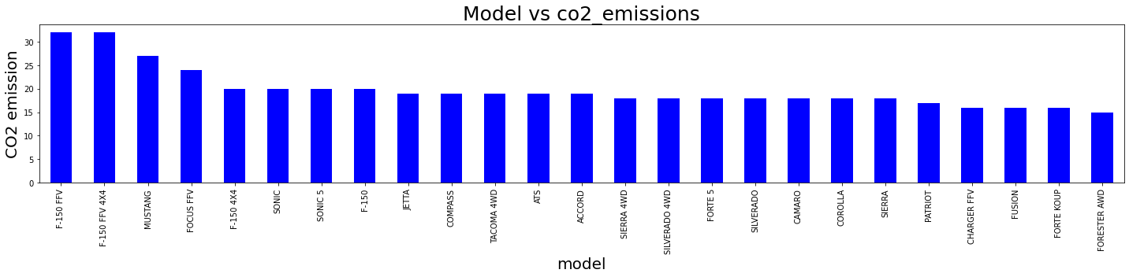
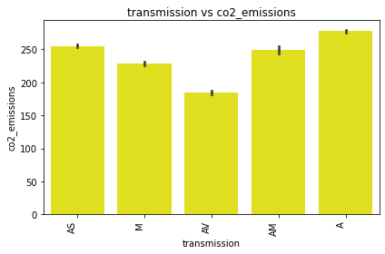
EDA (Bivariate Analysis)

Slide 10
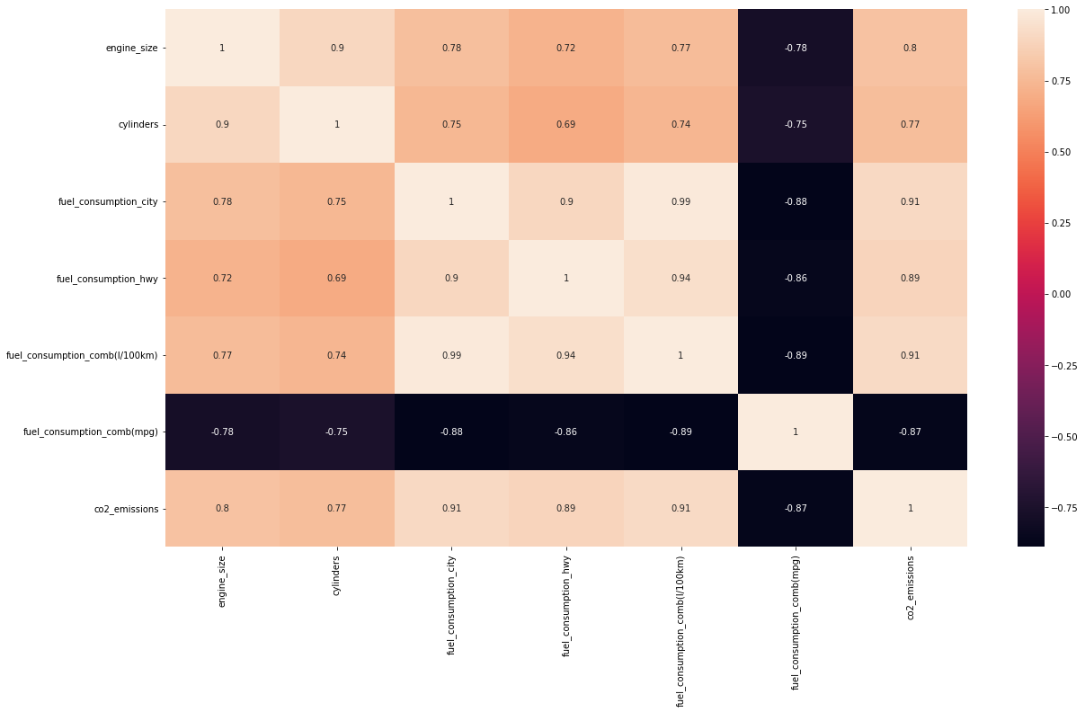
EDA (Correlation Analysis)

Slide 11
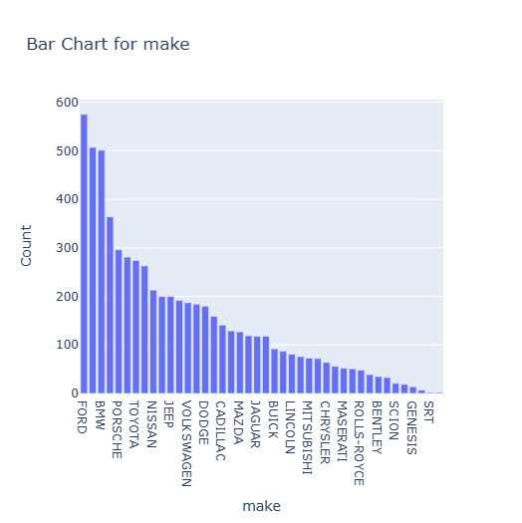
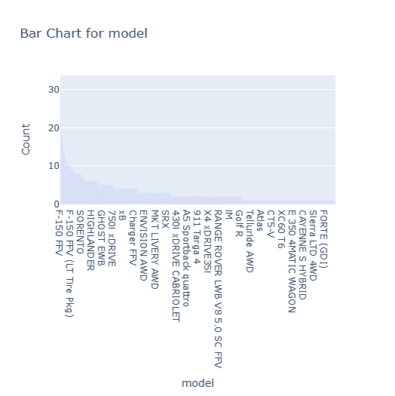
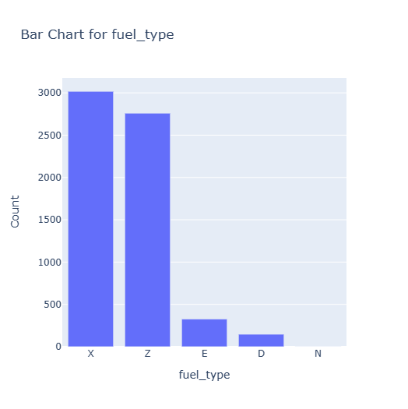
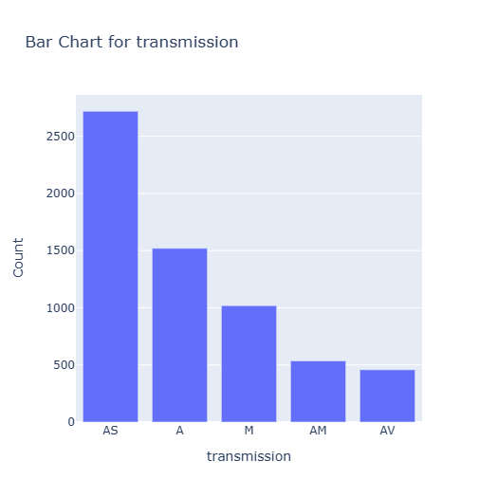
visualize all categorical columns
1. From the bar graphs, we can see that the "model" class is not discrete but continuous.
2. It means there are various categories in the same and so will give rise to sparse matrix.
3. All the other bar graphs are clean and we can use frequency encoding for eliminating the sub-categories which are in minority.

Slide 12
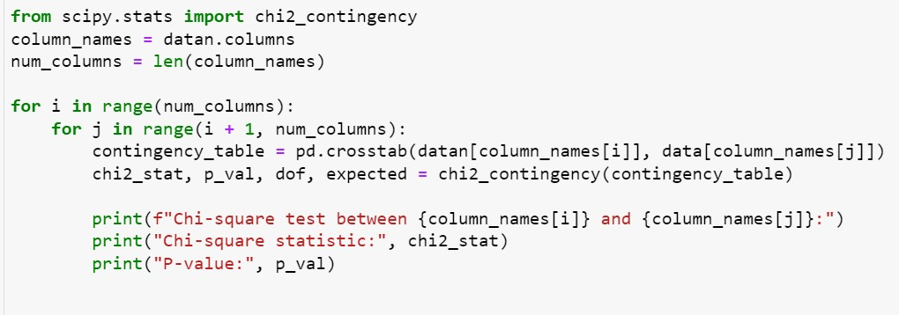
Chi-square Test to find association between the categorical variables
Ho: There is no association
between the two categories
2. Ha: There is association
between the two categories
1. From the Chi-square analysis we can see that the p-value for all the categories is less than 0.05
2. This indicates that there is a greater correlation between the categories

Slide 13
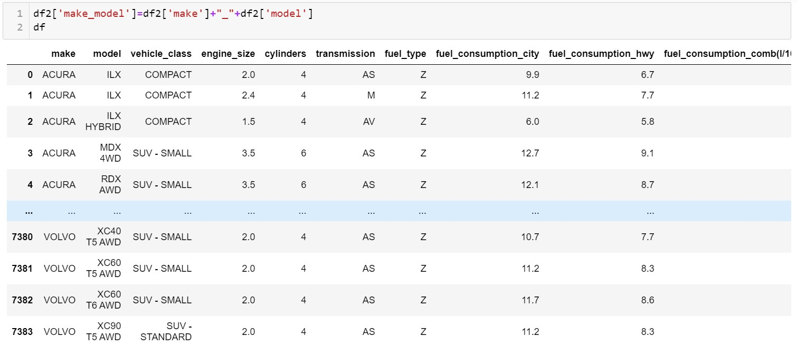
We combine Make and Model as they both are highly associated and also they are dependent on each other.

Slide 14
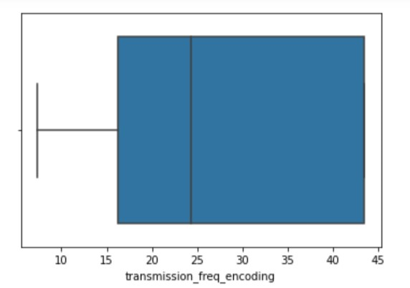
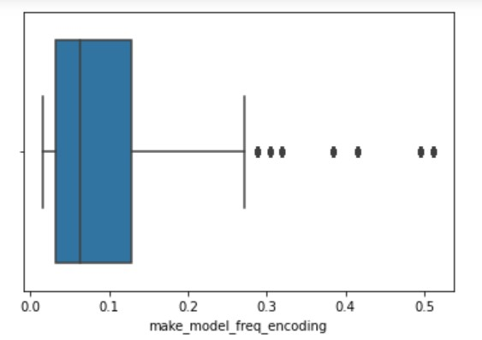
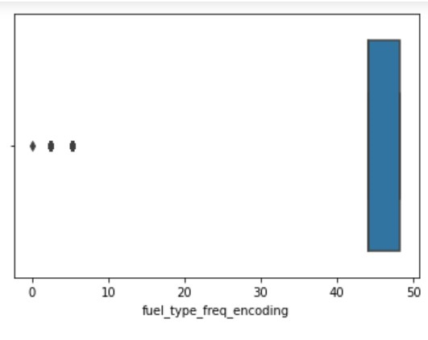
Outlier Detection for Categorical Data

Slide 15
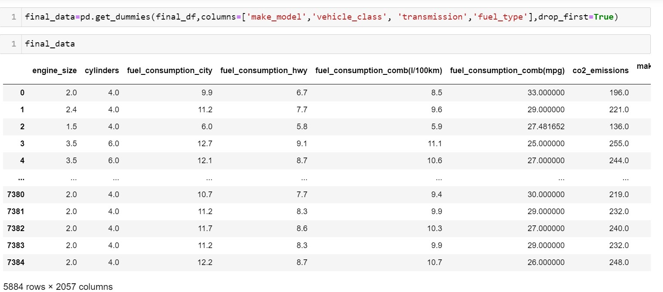
Treating the outliers
Treated the outliers using one hot encoding

Slide 16
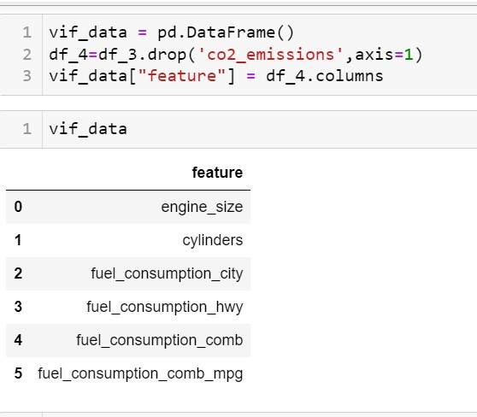
Variable Inflation Factor

Slide 17
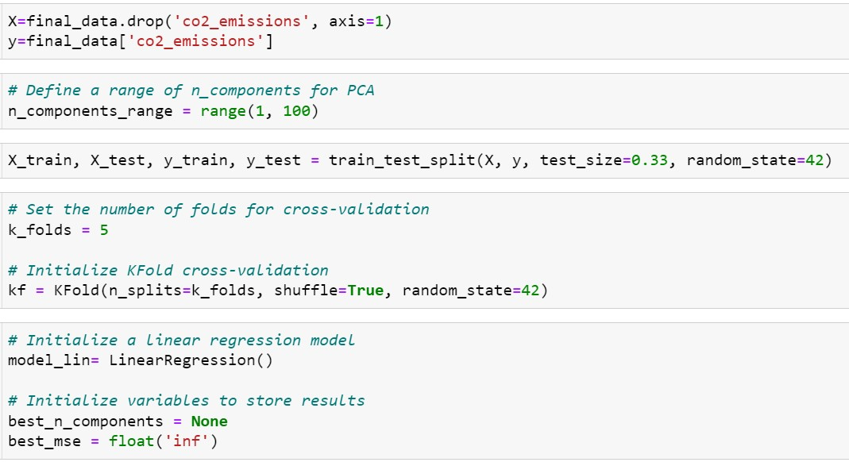
Performing PCA and Preparing the Dataset
Performed PCA and divided the data into training and testing test to build models

Slide 18
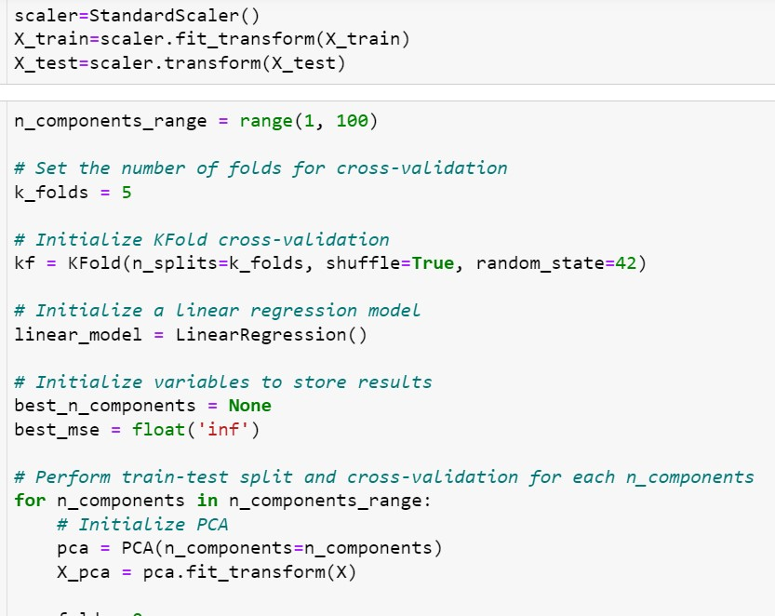
SCALING

Slide 19
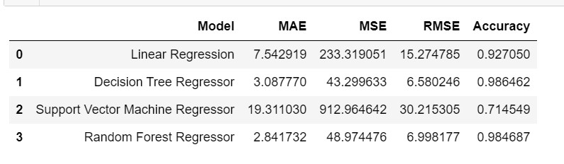
MODEL BUILDING
Created Decision Tree Regression, SVM Regressor, Random Forest Regressor models and selected the Decision Tree Regression model as it had less rmse value and higher accuracy as compared to other models.

Slide 20
Deployment using Streamlit

Slide 21
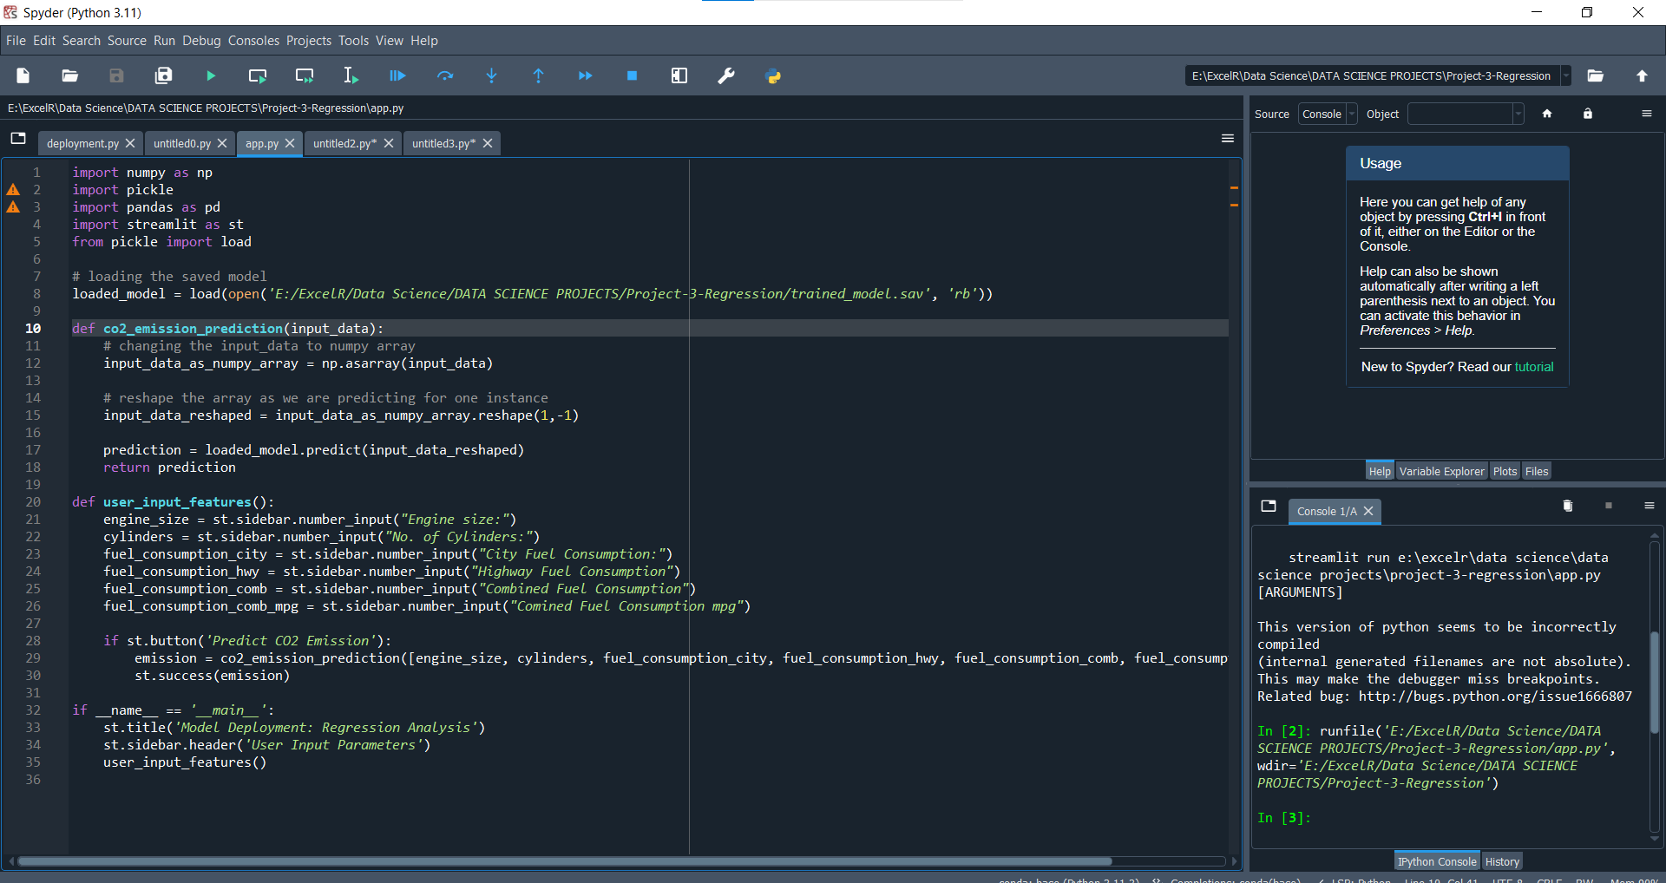
Python File used for deployment

Slide 22
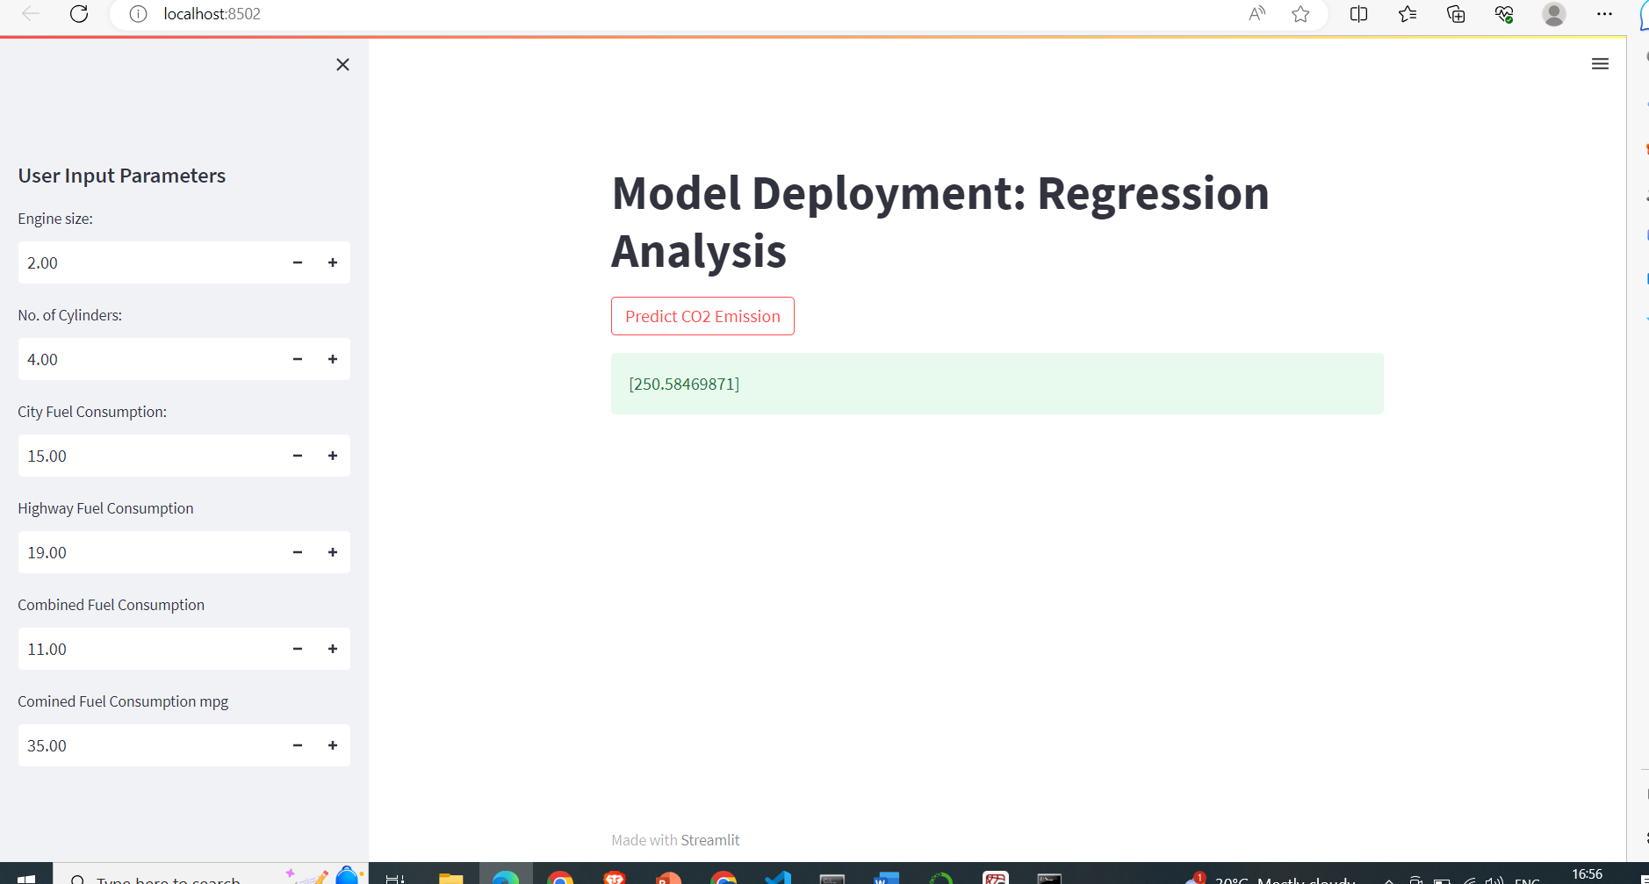

Slide 24
Thank You!

